Slide 1
Computer Vision – Module 2
Dr. Sreejith Rajan

Slide 2
Image Enhancement - Overview
Image enhancement improves visual quality or prepares image for further processing.
Enhancement includes:
Contrast enhancement
Intensity normalization
Smoothing
Noise removal
Important:
👉 Enhancement improves perception 👉 It does NOT add new information

Slide 3

Contrast Enhancement
If intensity values lie in a narrow range → image looks dull.
We stretch values to full range 0–255.
Mathematical Model
$$I_{new}=\frac{I−I_{min}}{I_{max}−I_{min}}×255$$
Linear transformation.

Slide 4
Characteristics
✔ Global operation ✔ Preserves relative brightness ✔ Does NOT remove noise ✔ Improves dynamic range
Applications
X-ray image improvement
Satellite images
Underexposed images

Slide 5

Contrast Normalisation
Standardize intensity of the image (Mostly for ML)
Formula
$$I_{norm}=\frac{I−μ}{σ}$$
Characteristics
✔ Mean = 0 ✔ Variance = 1 ✔ Used before CNN input ✔ Produces negative values

Slide 6
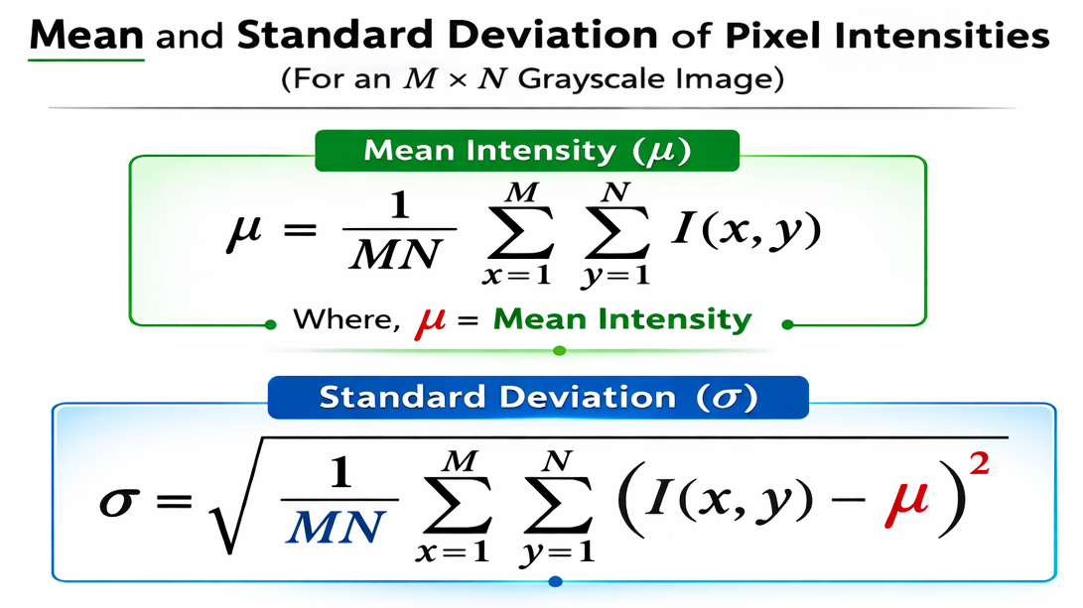
mean = average intensity of all 65,536 pixels
std = spread of intensity values (contrast measure)

Slide 7
Image Smoothing
Reduce high-frequency components (noise).
Noise = rapid pixel fluctuations.
Smoothing = Low-pass filtering.
Types of smoothing
Mean filter
Gaussian Filter
Median Filter

Slide 8

Mean Filter
1️⃣ Mean Filter
Kernel:
$$\frac{1}{9}\left[\begin{matrix}1 & 1 & 1 \\ 1 & 1 & 1 \\ 1 & 1 & 1\end{matrix}\right]$$
Characteristics:
✔ Simple ✔ Linear ✔ Blurs edges ✔ Reduces Gaussian noise

Slide 9

Gaussian Filter
Formula:
$G\left(x , y\right)=\frac{1}{2πσ^{2}}e^{−\frac{x^{2}+y^{2}}{2σ^{2}}}$
Characteristics:
✔ Linear ✔ Better edge preservation ✔ Controlled by σ ✔ Used in Canny edge detection

Slide 10
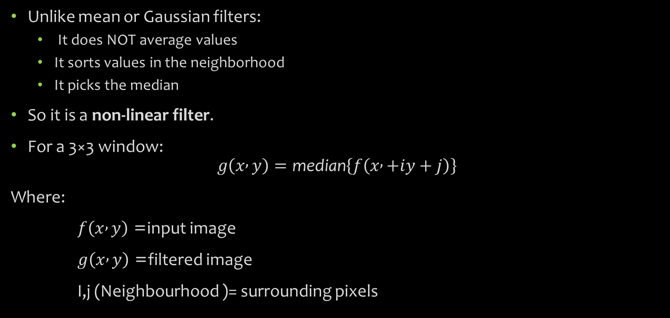
Median Filter
Unlike mean or Gaussian filters:
It does NOT average values
It sorts values in the neighborhood
It picks the median
So it is a non-linear filter.
For a 3×3 window:
$$g\left(x , y\right)=\text{median}\left\{f\left(x , +iy+j\right)\right\}$$
Where:
$f\left(x , y\right)$= input image
$g\left(x , y\right)$= filtered image
I,j (Neighbourhood )= surrounding pixels

Slide 11
Applications
✔ Biomedical images ✔ Surveillance systems ✔ Faulty sensor correction ✔ Preprocessing before segmentation
Filter | Linear? | Good for Gaussian Noise | Good for Salt & Pepper | Edge Preservation
Mean | Yes | Moderate | Poor | Poor
Gaussian | Yes | Good | Poor | Moderate
Median | No | Moderate | Excellent | Excellent

Slide 12
Rank Filters
Instead of median, choose kth element.
Min filter → erosion
Max filter → dilation

Slide 13
Erosion and Dilation
They are morphological operations used to process shapes in images.
They work using a small matrix called a structuring element (kernel).
They are commonly applied to:
Binary images
Grayscale images
Segmented objects
Effect
✔ Expands objects ✔ Fills small holes ✔ Connects nearby components ✔ Thickens boundaries

Slide 14
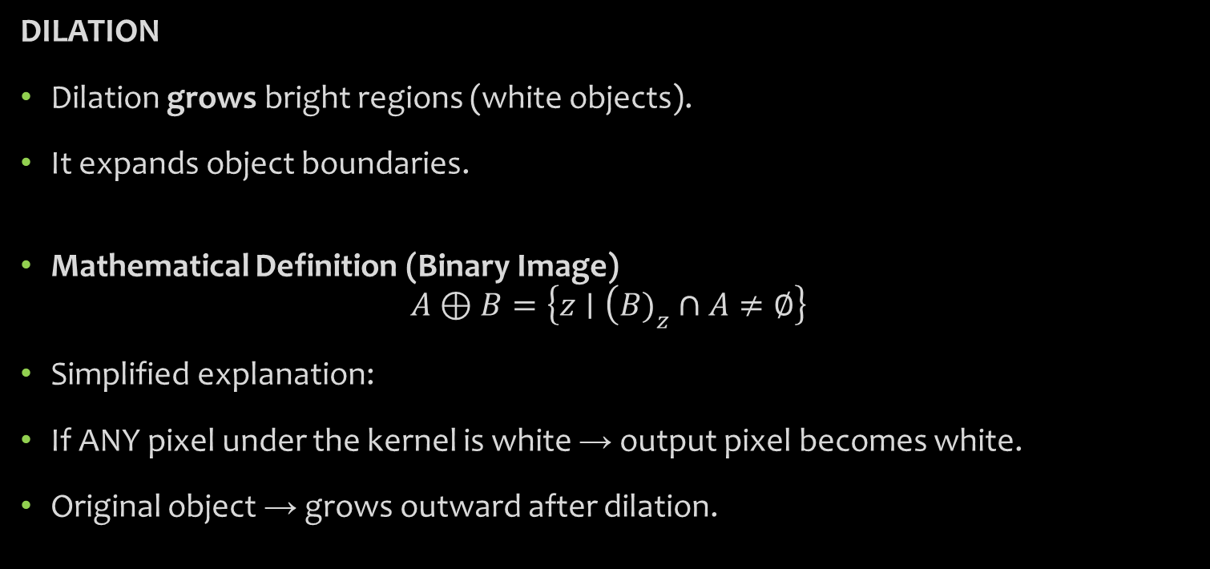
DILATION
Dilation grows bright regions (white objects).
It expands object boundaries.
Mathematical Definition (Binary Image)
$$A⊕B=\left\{z∣\left(B{\left.)\right.}_{z}∩A≠∅\right\}\right.$$
Simplified explanation:
If ANY pixel under the kernel is white → output pixel becomes white.
Original object → grows outward after dilation.

Slide 15
EROSION
Erosion shrinks bright regions.
It removes boundary pixels.
✔ Shrinks objects ✔ Removes small noise ✔ Breaks thin connections ✔ Thins boundaries

Slide 16
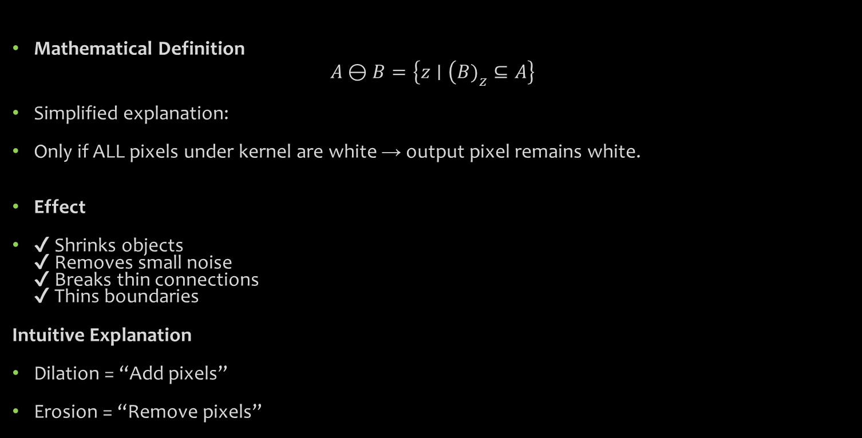
Mathematical Definition
$$A⊖B=\left\{z∣\left(B{\left.)\right.}_{z}⊆A\right\}\right.$$
Simplified explanation:
Only if ALL pixels under kernel are white → output pixel remains white.
Effect
✔ Shrinks objects ✔ Removes small noise ✔ Breaks thin connections ✔ Thins boundaries
Intuitive Explanation
Dilation = “Add pixels”
Erosion = “Remove pixels”

Slide 17
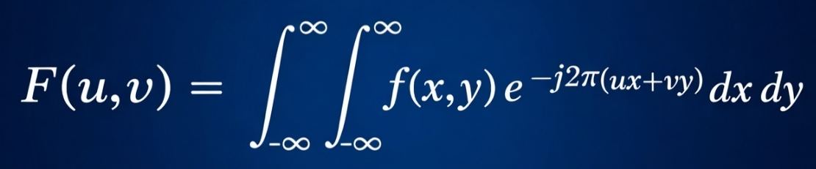
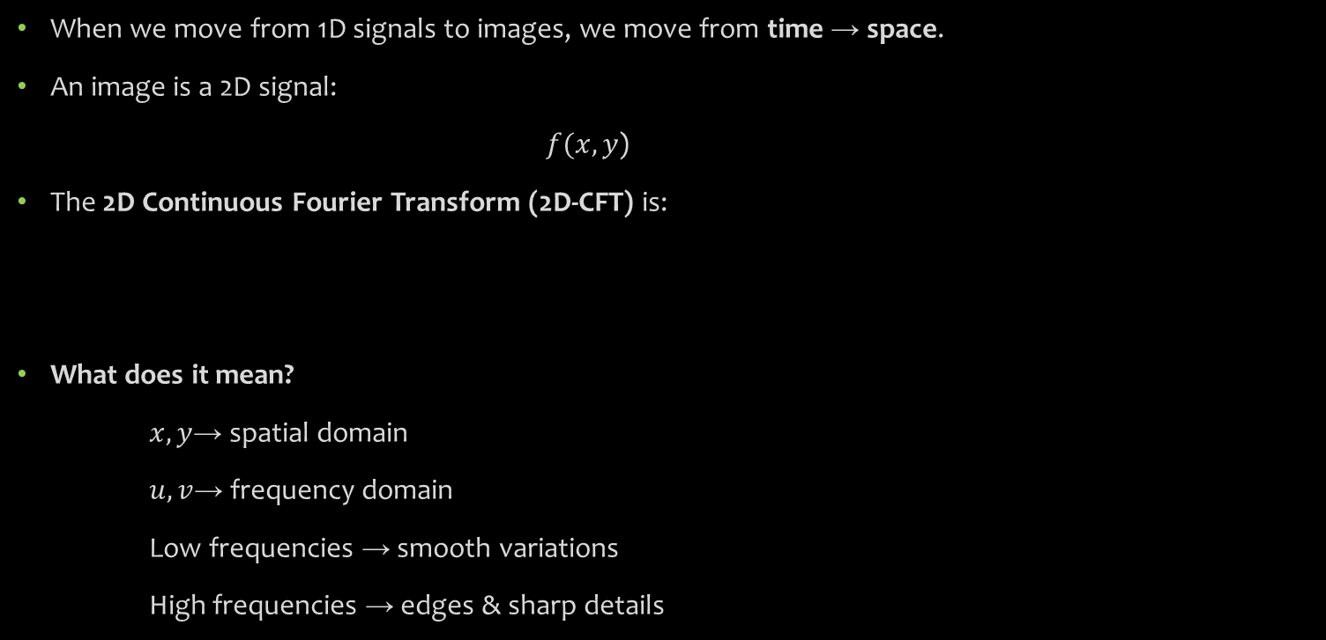
2D Fourier Transform (Image Frequency Analysis)
When we move from 1D signals to images, we move from time → space.
An image is a 2D signal:
$f(x,y$)
The 2D Continuous Fourier Transform (2D-CFT) is:
What does it mean?
$x,y$→ spatial domain
$u,v$→ frequency domain
Low frequencies → smooth variations
High frequencies → edges & sharp details

Slide 18
Image filtering
Compression
Pattern recognition
Biomedical imaging etc

Slide 19

Discrete Fourier Transform(DFT)
Now in digital systems , signals are discrete.
For N samples:
$$X\left(k\right)=\sum_{n=0}^{N−1}{x}\left(n\right)e^{−j2πkn/N}$$
Why DFT matters:
Implementable in software
Used in FFT algorithms
Image processing
Audio processing
Embedded DSP

Slide 20
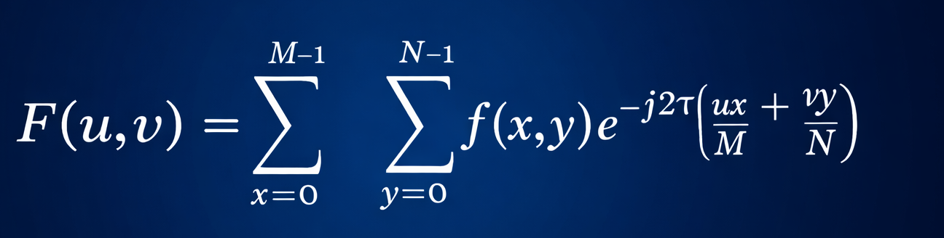
2D DFT(for images)

Slide 21
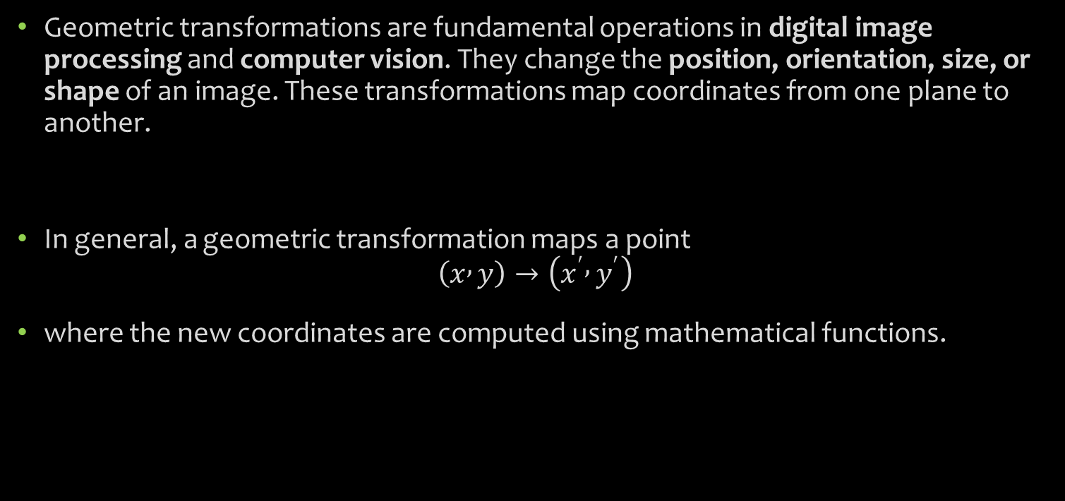
Geometric Transformations
Geometric transformations are fundamental operations in digital image processing and computer vision. They change the position, orientation, size, or shape of an image. These transformations map coordinates from one plane to another.
In general, a geometric transformation maps a point
$$\left(x , y\right)→\left(x^{′} , y^{′}\right)$$
where the new coordinates are computed using mathematical functions.

Slide 22
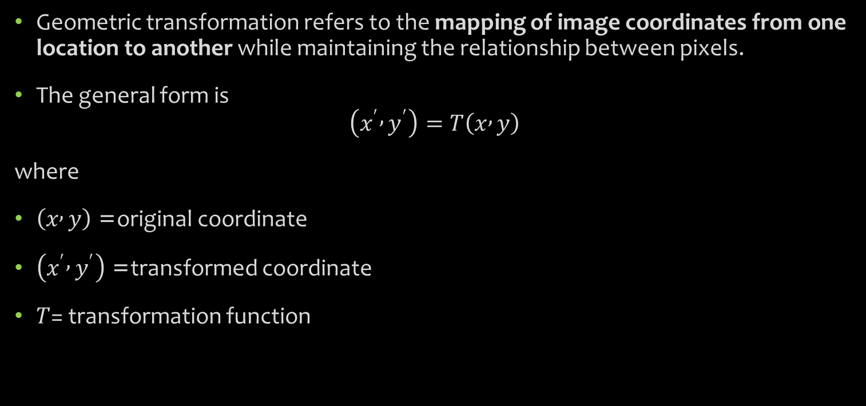
Geometric transformation refers to the mapping of image coordinates from one location to another while maintaining the relationship between pixels.
The general form is
$$\left(x^{′} , y^{′}\right)=T\left(x , y\right)$$
where
$\left(x , y\right)$= original coordinate
$\left(x^{′} , y^{′}\right)$= transformed coordinate
$T$= transformation function

Slide 23
Common geometric operations include:
Translation – shifting an image
Rotation – rotating an image around a point
Scaling – resizing the image
Shearing – slanting the image
Reflection – mirroring the image
Most of these can be represented using matrix operations.

Slide 24
Classification of Geometric Transformation
Geometric Transformations can be divided as
Rigid transformation
Similarity Transformation
Affine Transformation
Projective Transformations

Slide 25

Rigid Transformation
Rigid transformations preserve shape, size, distance, and angles.
Allowed operations:
Translation
Rotation
Reflection
Properties preserved:
Distance
Angles
Parallel lines
Shape and size
Example:
$$x^{′}=x\cos{θ}−y\sin{θ}+t_{x}$$
$$y^{′}=x\sin{θ}+y\cos{θ}+t_{y}$$
Applications:
Object tracking
Robotics
Computer graphics

Slide 26

Similarity transformation
Similarity transformation allows scaling along with rotation and translation.
Operations allowed:
Translation
Rotation
Uniform scaling
Properties preserved:
Shape
Angles
Parallel lines
But size changes.
Example:
$$x^{′}=s\left(x\cos{θ}−y\sin{θ}\right)+t_{x}$$
$$y^{′}=s\left(x\sin{θ}+y\cos{θ}\right)+t_{y}$$
Applications:
Image resizing
Object detection
Pattern recognition

Slide 27

Affine transformation
Affine transformation is more general than similarity transformation.
Operations allowed:
Translation
Rotation
Scaling
Shearing
Properties preserved:
Straight lines remain straight
Parallel lines remain parallel
But angles and lengths are not preserved.
Matrix form:
$$\left[\begin{matrix}x^{′} \\ y^{′} \\ 1\end{matrix}\right]=\left[\begin{matrix}a_{11} & a_{12} & t_{x} \\ a_{21} & a_{22} & t_{y} \\ 0 & 0 & 1\end{matrix}\right]\left[\begin{matrix}x \\ y \\ 1\end{matrix}\right]$$
Applications:
Image registration
Image alignment
Texture mapping

Slide 28
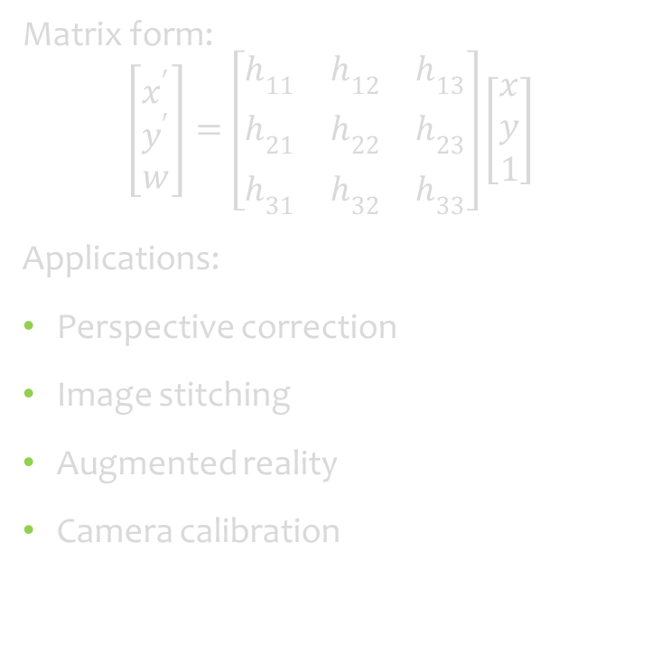
Projective Transformation
Projective transformation (homography) is the most general geometric transformation used in image processing.
Operations allowed:
All affine operations
Perspective distortion
Properties preserved:
Straight lines remain straight
But:
Parallel lines may intersect.
Matrix form:
$$\left[\begin{matrix}x^{′} \\ y^{′} \\ w\end{matrix}\right]=\left[\begin{matrix}h_{11} & h_{12} & h_{13} \\ h_{21} & h_{22} & h_{23} \\ h_{31} & h_{32} & h_{33}\end{matrix}\right]\left[\begin{matrix}x \\ y \\ 1\end{matrix}\right]$$
Applications:
Perspective correction
Image stitching
Augmented reality
Camera calibration

Slide 29

Relationship
Finally
$$Rigid⊂Similarity⊂Affine⊂Projective$$

